Slide 1
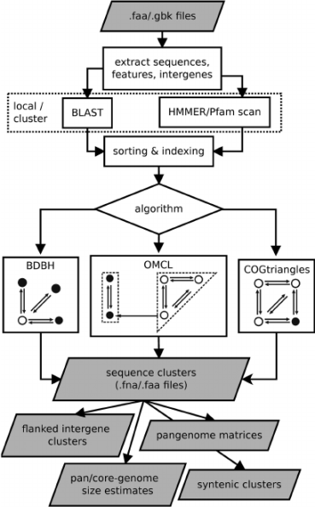
accessory
genome A 35 11 25
101 genome B
9 24
22
genome C
cloud
core
shell
Notes:
Pan-genome of three genomes (A, B and C). Core loci (101) are found in all genomes and hence have occupancy = 3. Accessory loci are allocated to shell and cloud compartments. In this example, shell loci (11+9+24=44) are found in two accessions and cloud loci (35+25+22=82) are annotated only in one genome. The pan-genome size is 82+44+101=227 loci.

